Slide 1
Async: ABC-DR Presentation
Ian Comey, Callista Napitupulu, Kevin Thomas

Slide 2
Project Description
Async is an online platform for classrooms that integrates course groups with organizational features. An easy-to-navigate UI is prioritized so that features like the course pages, assignment feed, calendar, and discussions can be fully taken advantage of.
We leverage modern web technologies to integrate course content, assignment submissions, real-time notifications, and interactive discussion forums into one single platform.

Slide 3
Project Goals
Create useful educational and organizational features for students.
Design an intuitive and accessible UI for users.
Manage user accounts with authentication best practices.
Improve our own skills in full-stack development.

Slide 4
Justification
Opportunity to Extend Learning:
This project is well-suited for our team because it provides opportunities to simultaneously learn, research, practice, and apply our existing skills with web development. It also gives us the flexibility to use familiar tools while encouraging us to explore new technologies.
Appropriate Technical Difficulty:
The project presented an appropriate level of technical difficulty by challenging us to make deliberate decisions regarding both the application's design and the selection of tools and libraries used to build the site.

Slide 5
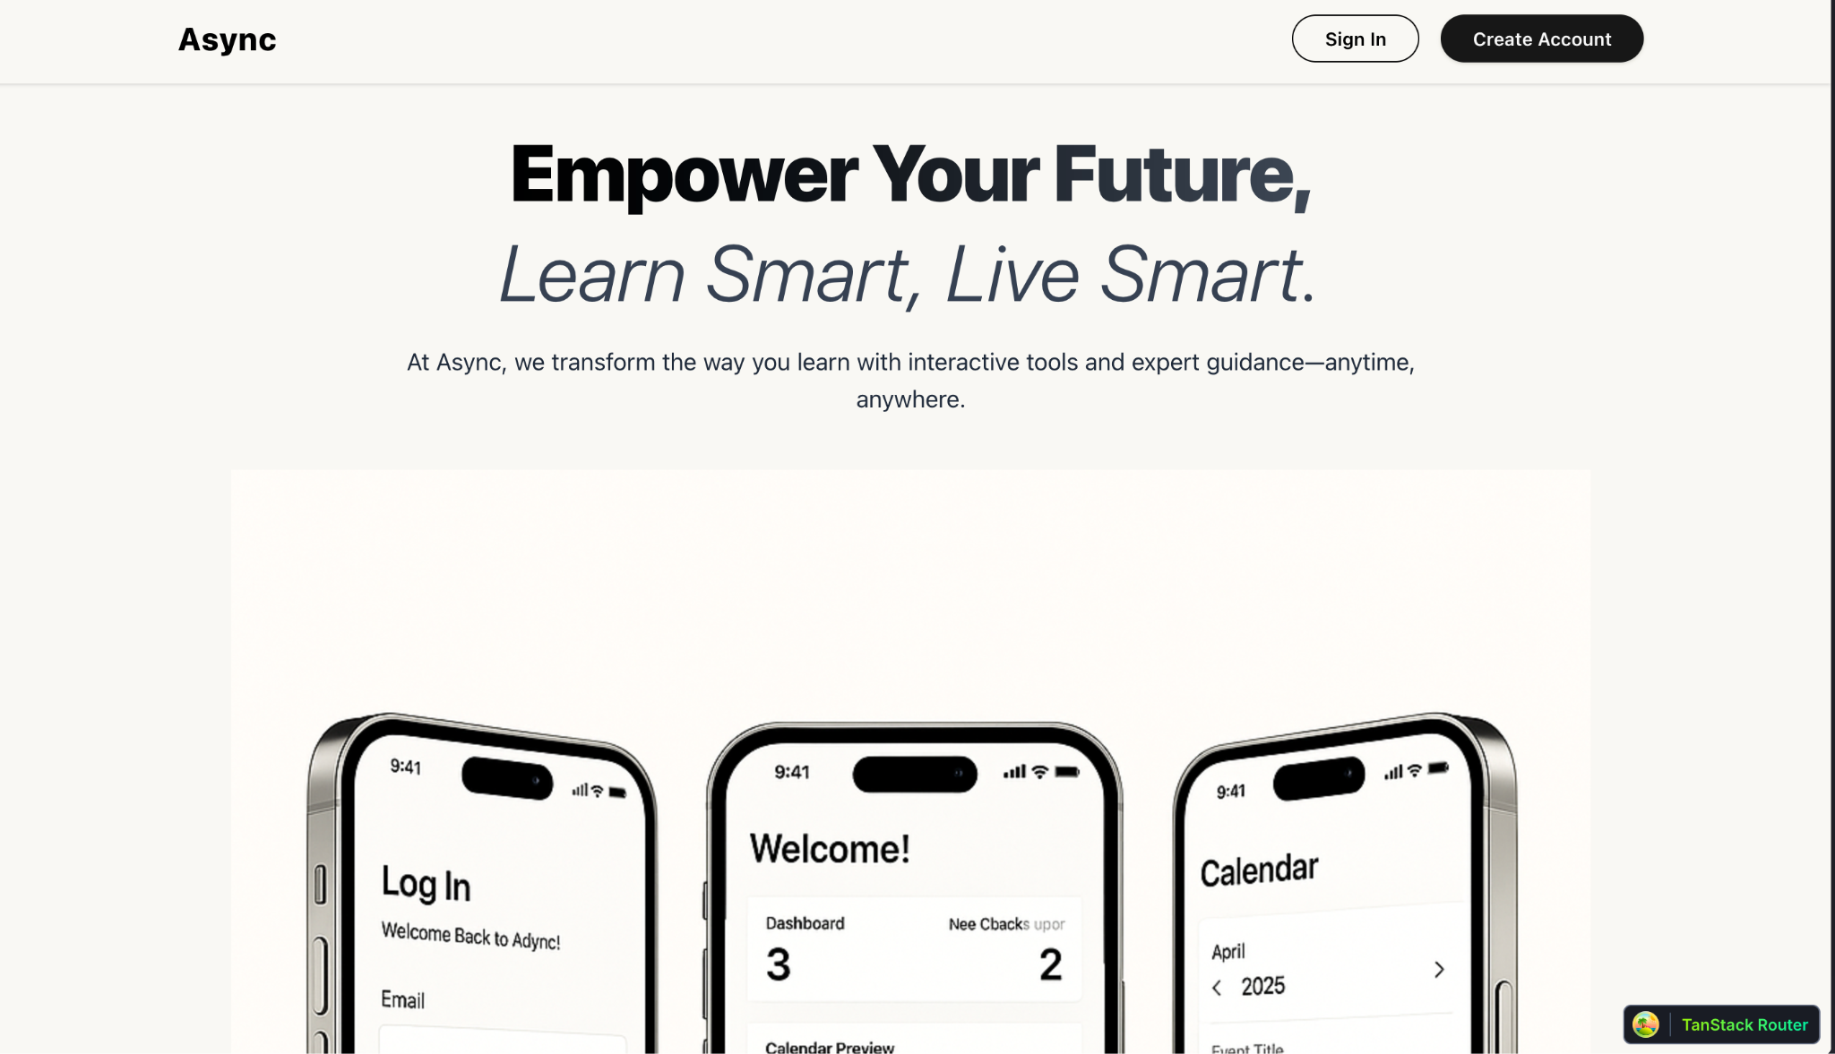
Screenshot (Home)

Slide 6
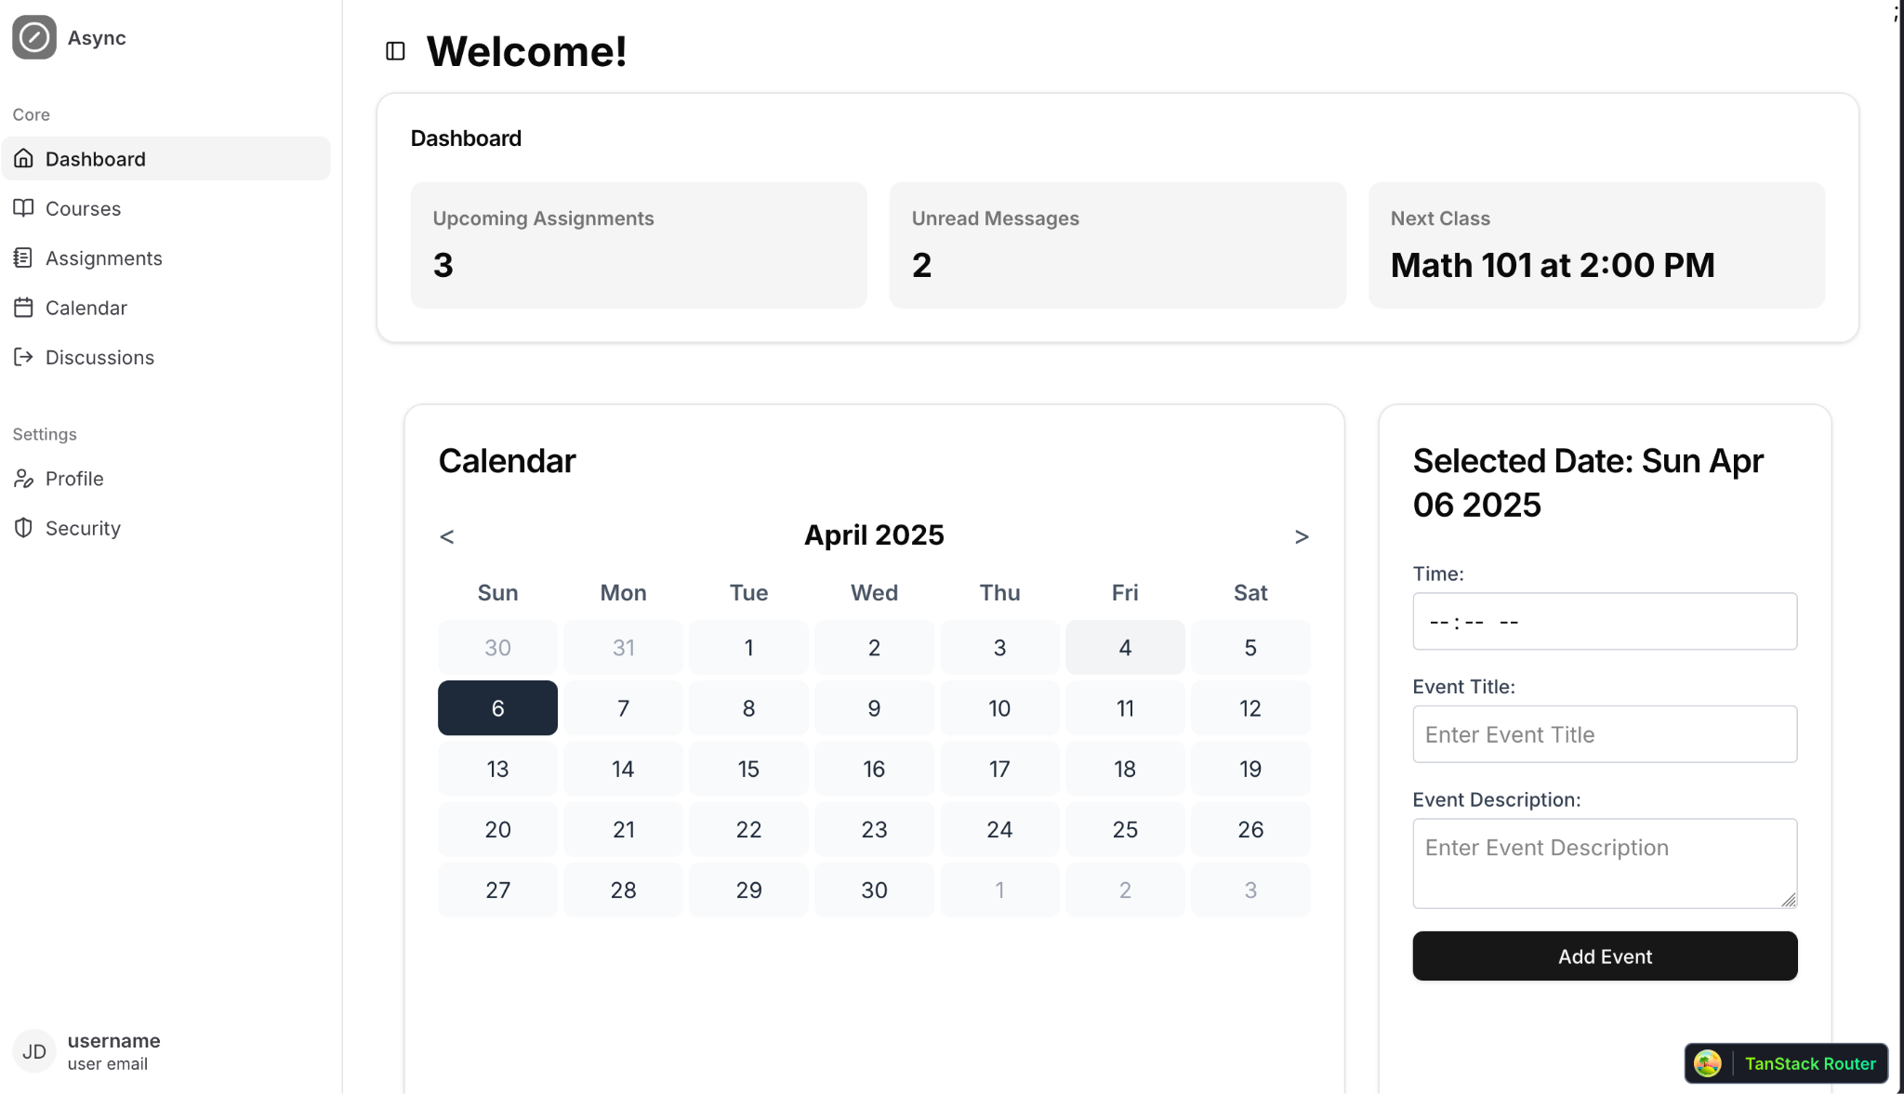
Screenshot (Logged-in)

Slide 7
Demo

Slide 8
Project Challenges
1 - Key Feature Bugs
Bugs related to routing and data fetching were particularly challenging and had a wide-reaching impact across the platform. These issues disrupted page navigation, conditional rendering, and the display of user-specific data.
2 - Prioritizing Features
The set of features for students vs. teachers are very different. Much of our focus was spent on the student side of things.
Notes:
1- As a result, we spent significant time evaluating our route handling and data table structure to determine whether the problems stemmed from deeper architectural decisions.

Slide 9
Status Update
Accomplishments
Successfully migrated to a new backend and database.
Re-designed all existing key features and pages.
Implemented authenticated routes and redirect logic to ensure security.
Designed and added a few new pages.
Scheduled Tasks
Finish up features for courses and calendar.
Other UI tweaks.

Slide 10
Thank You!

